Slide 1
Statistical Analysis of Salt Flooding on Juvenile Maritime Tree Species
Abby Eck, Odalys Barrientos, & Kyle Anderson

Slide 2
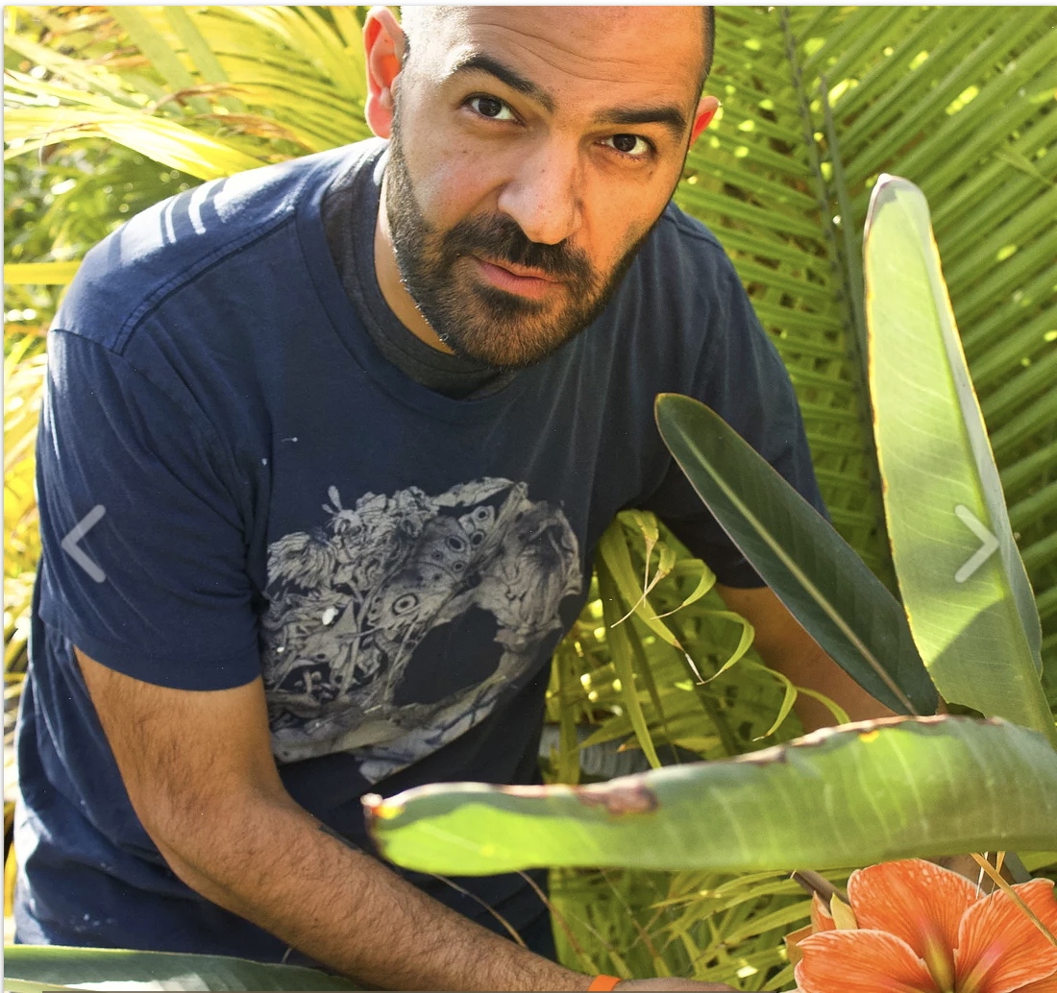
Client: Dr. Daneshgar
Dr. Daneshgar is a plant ecologist who specializes in climate change impacts on coastal forests in New Jersey and the Bahamas
Attended the University of Delaware and the University of Florida
Some of his hobbies include watching movies, screenwriting, and collect expensive paper

Slide 3
Research Question
HOW DOES SALINITY AFFECT JUVENILE COASTAL TREES?

Slide 4
Research Hypotheses
By the different levels of salinity and frequency . . .
There will be a difference in biomass
There will be a difference in the probability of dying at any point in time

Slide 5
Benefits of the Study
We will know what forests will look like in the future due to climate change.
If everything gets wiped out this will affect our water intake, the shore, and hurricane protection.
Managers can come up with solutions to conserve or preserve forests.
There are other species that depend on these coastal forest

Slide 6
Variables
Explanatory
Response
Treatments
Salinity Level (0ppt, 5ppt, 10ppt, 15ppt)
Frequency (19 (1x a month), 30 (1x a week), 45 (3x a week))
Species
Time
Total Biomass
Mortality

Slide 7
Experiment Set-Up Salinity
128 Trees
Sweet Gum
(LS)
Pitch Pine
(PR)
Black Gum
(NS)
Willow Oak (QP)
Eastern Red
Cedar
(JV)
Red Maple
(AR)
Black Cherry
(PS)
Southern Red Oak (QF)
0
0
15
0
15
15
0
15
5
5
10
5
10
5
10
0
10
0
15
0
15
0
15
15
5
10
5
10
5
10
5
10
There were four reps for each salinity level.
All trees were flooded with control(0ppt) twice a week and their indicated treatment once a week.

Slide 8
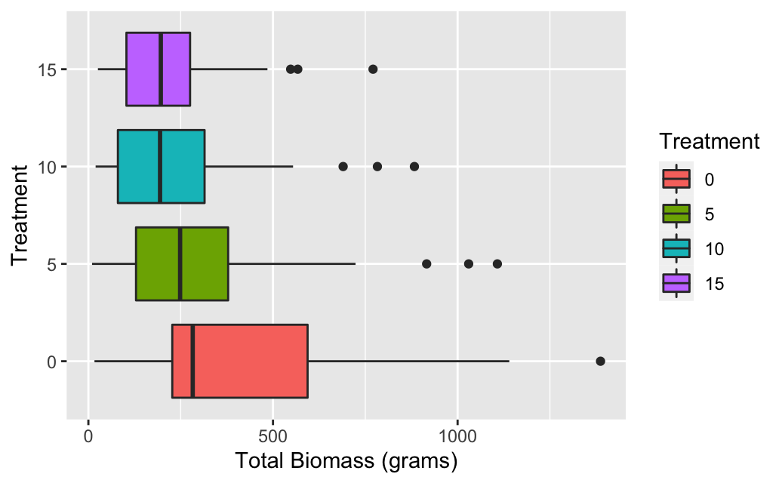
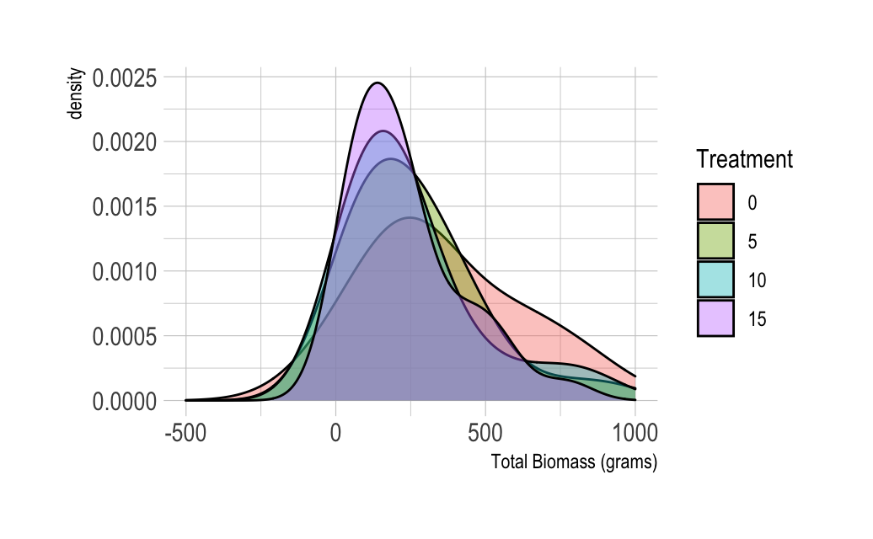
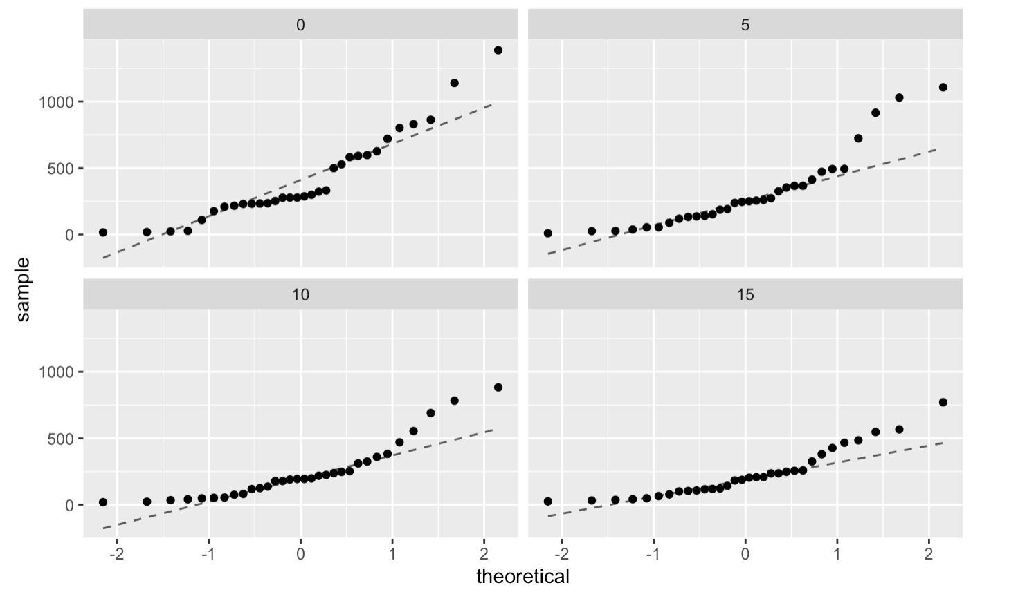
Salinity Data by Treatment

Slide 9
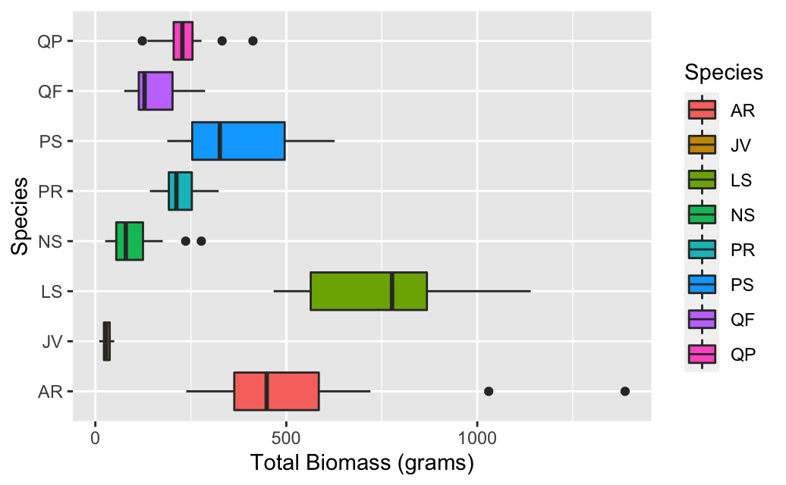
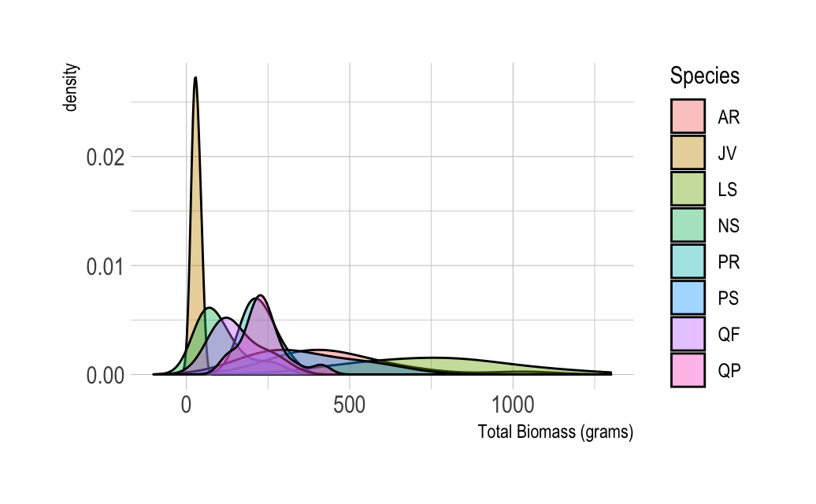
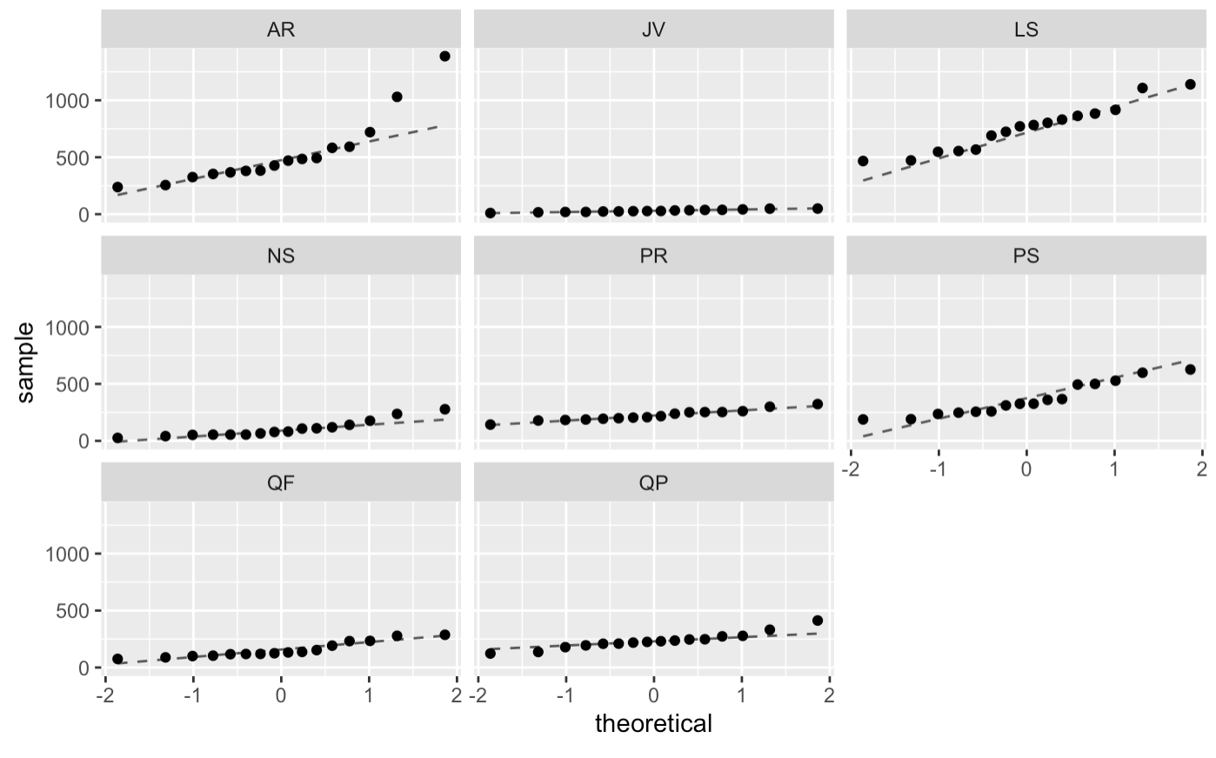
Salinity Data by Species

Slide 10
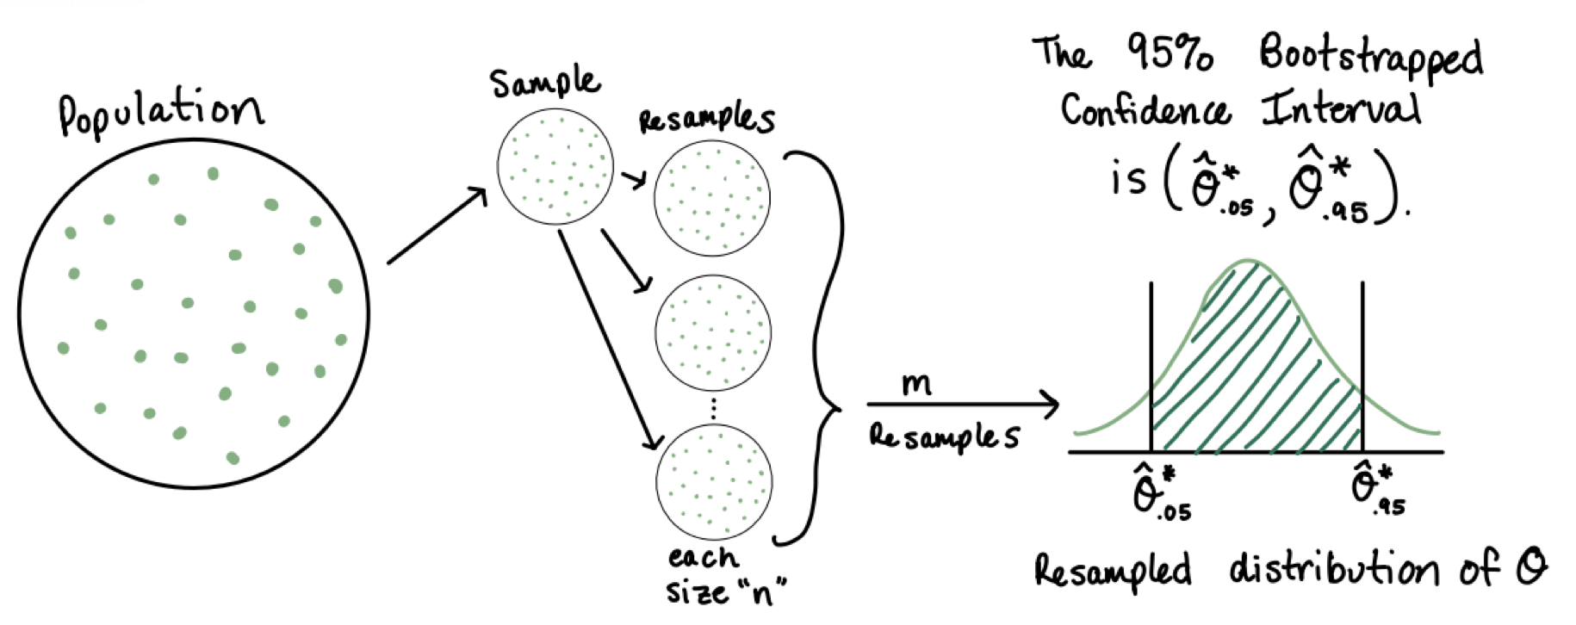
Bootstrapped ANOVA
Analysis of variance (ANOVA) is a statistical method to test if there is a significant difference between two or more treatment groups. Since our data does not meet the assumption of normality, we use the bootstrapped method of ANOVA. Bootstrapping is sampling with replacement from observed data to create simulated samples. These simulated samples estimate the statistic of interest. Bootstrapping is a useful alternative to the traditional method of hypothesis testing.

Slide 11
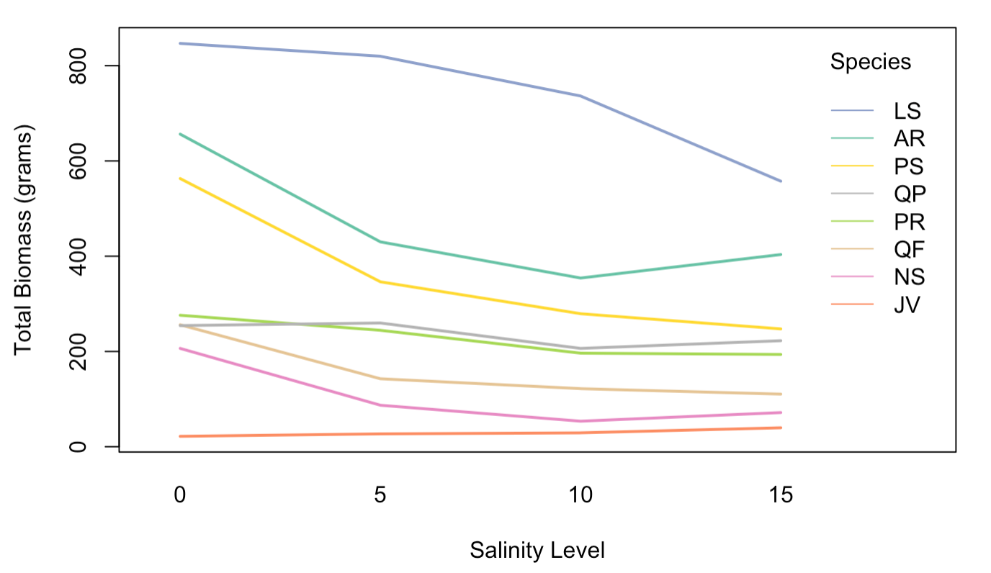
Means Plot for Salinity Data

Slide 12
Bootstrapped ANOVA (Salinity Data)
Red Maple (AR)
Eastern Red Cedar (JV)
Sweet Gum (LS)
Black Cherry (PS)
Willow Oak (QP)
Southern Red Oak (QF)
Black Gum (NS)
Pitch Pine (PR)
Ho: There is no difference in Total Biomass by Treatment
p=.081
p=.080
p=.145
p=.001
p=.001
p=.003
p=.018
p=.406

Slide 13
Experiment Set-Up Frequency
72 Trees
19: Once a Month
30: Once a Week
45: 3 times a Week
Sweet Gum
(LS)
Pitch Pine
(PR)
Black Gum
(NS)
Willow Oak (QP)
Eastern Red
Cedar
(JV)
Red Maple
(AR)
Black Cherry
(PS)
Southern Red Oak (QF)
19
30
45
19
19
30
45
19
30
45
30
45
19
30
45
19
19
30
45
19
45
30
45
30
There were three reps for each Frequency level.
All trees received the same amount of water per month but varied in frequency of the treatment of 10 ppt

Slide 14
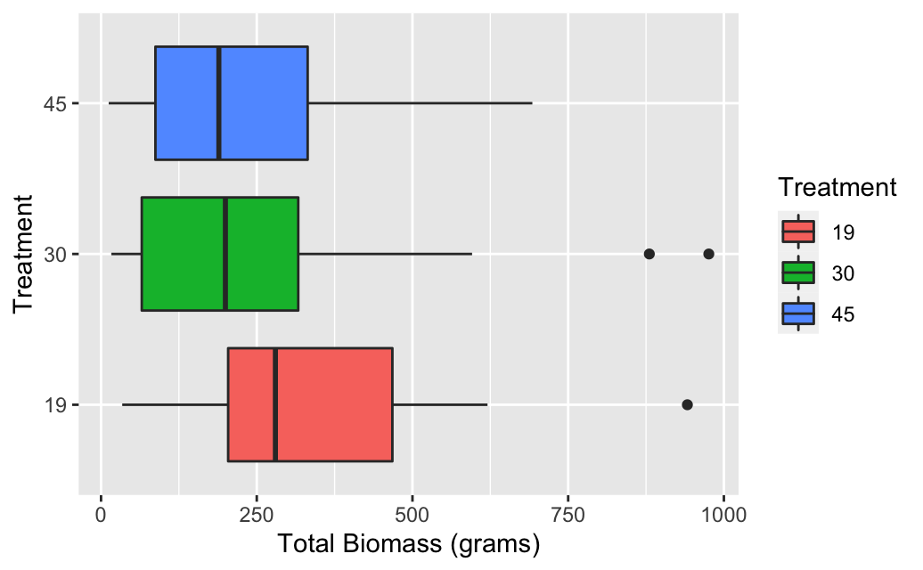
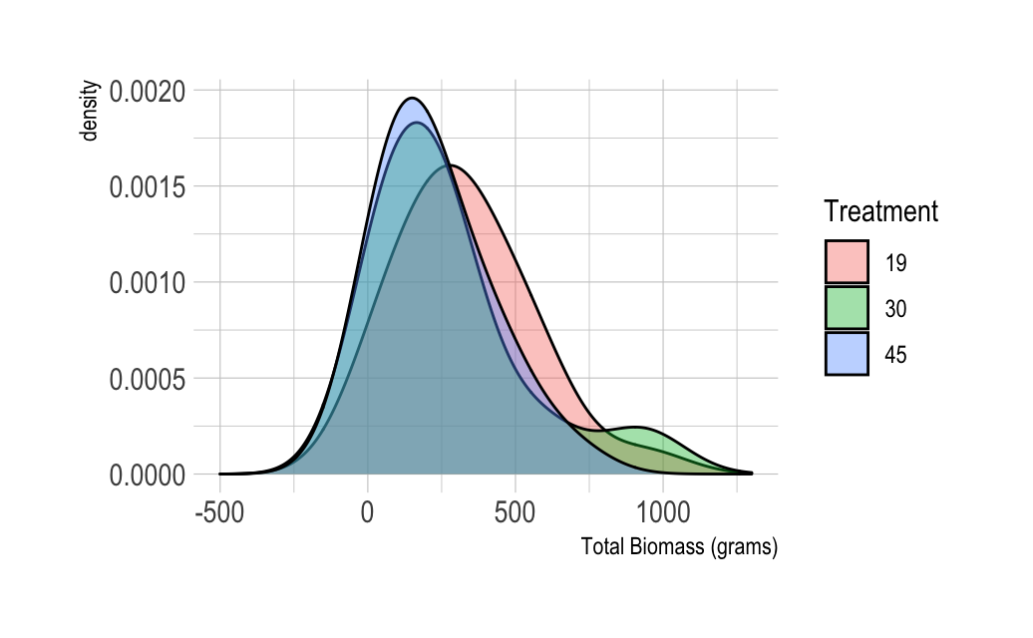
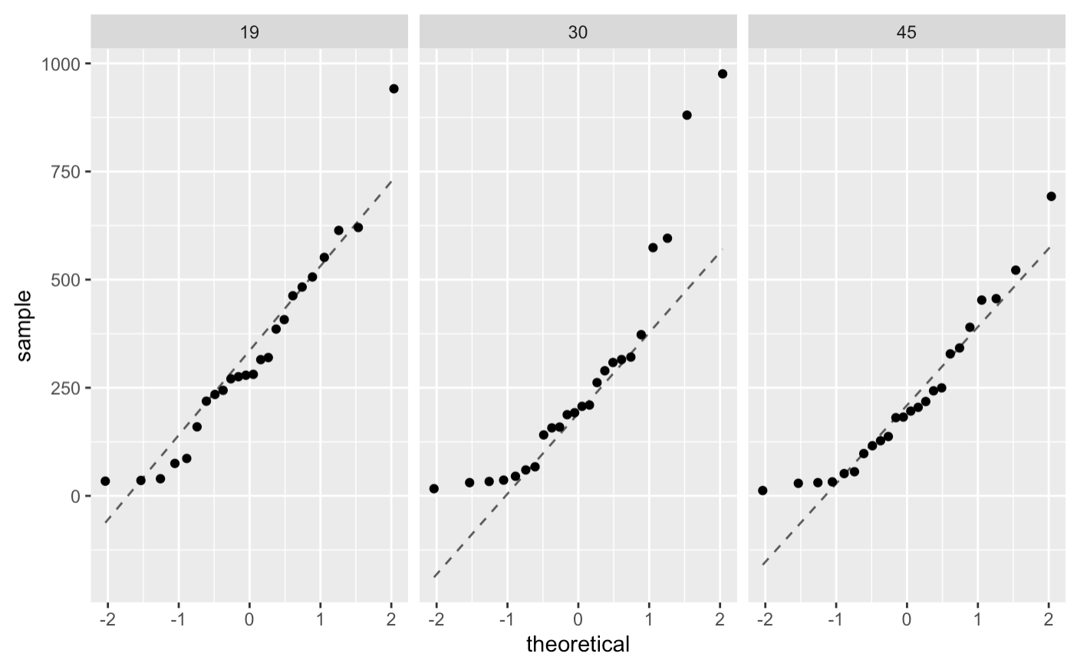
Frequency Data by Treatment

Slide 15
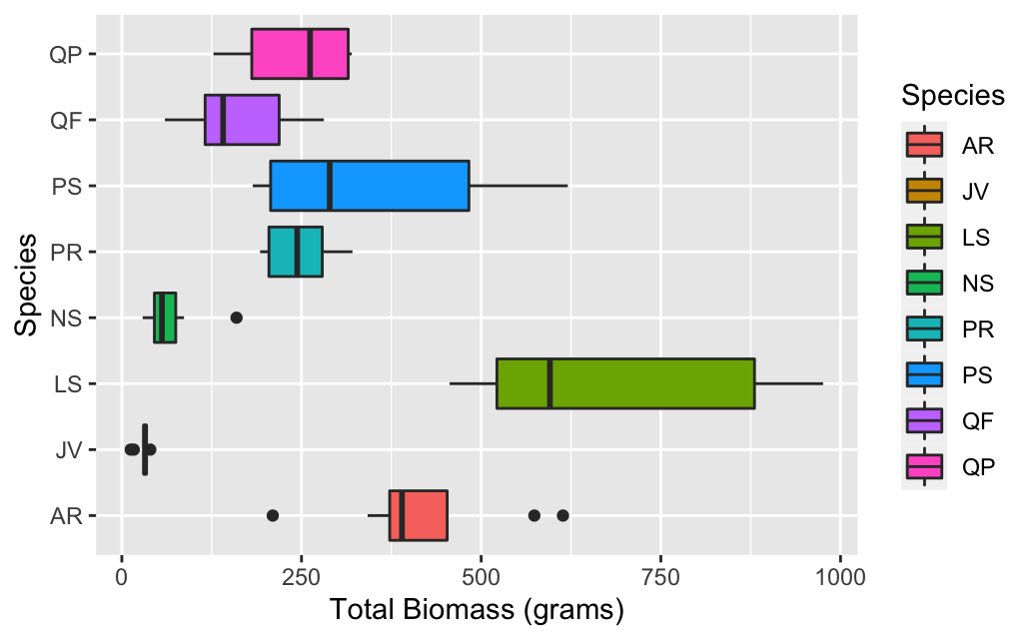
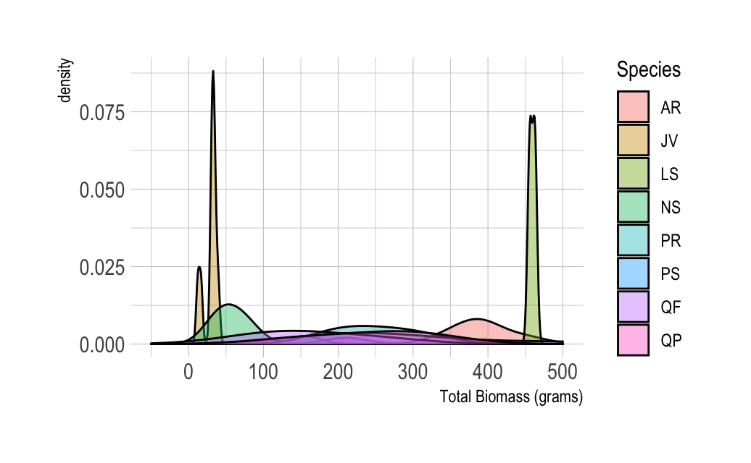
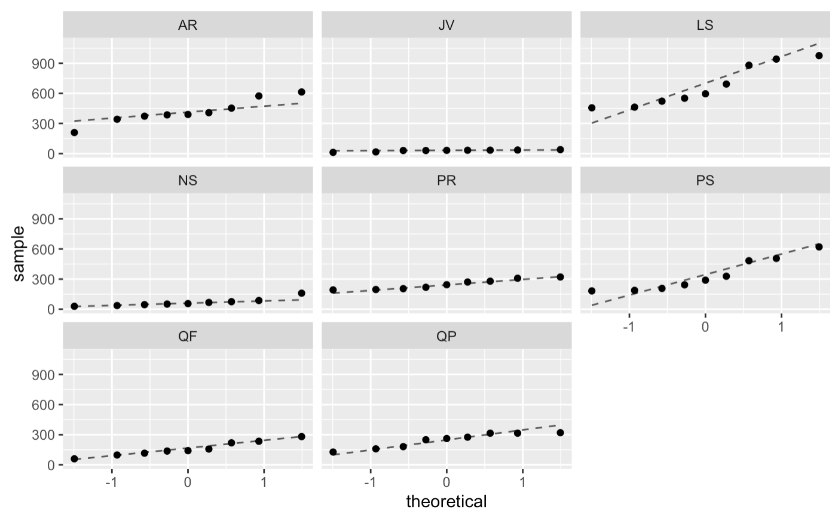
Frequency Data by Species

Slide 16
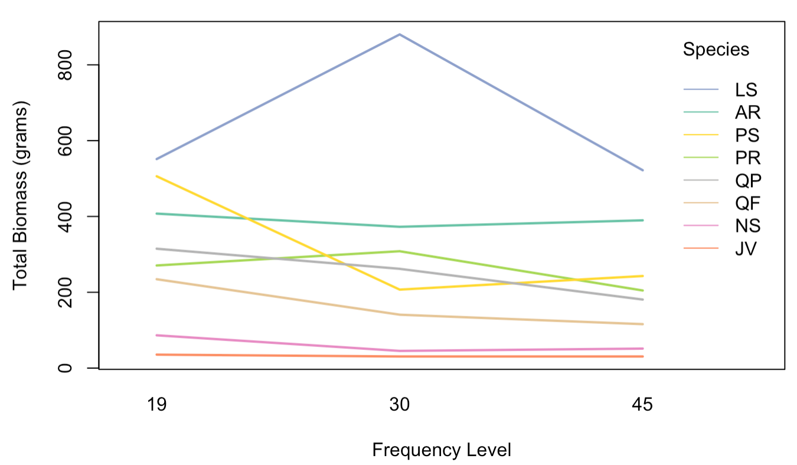
Means Plot for Frequency Data
19: Once a Month
30: Once a Week
45: 3 times a Week

Slide 17
Bootstrapped ANOVA (Frequency Data)
Red Maple (AR)
Eastern Red Cedar (JV)
Sweet Gum (LS)
Black Cherry (PS)
Willow Oak (QP)
Southern Red Oak (QF)
Black Gum (NS)
Pitch Pine (PR)
Ho: There is no difference in Total Biomass by Treatment
p=.730
p=.257
p=.317
p=.001
p=.107
p=.015
p=.060
p=.173

Slide 18
Survival Analysis
Survival analysis is the analysis of time-to-event
Event= Death of the tree
In our data set we are given the Julian Date of when each tree died
If the tree survived the experiment there was no date provided, thus the event is censored
A censored event gets a “0” meaning the tree was still alive and the event of interest did no occurred yet

Slide 19
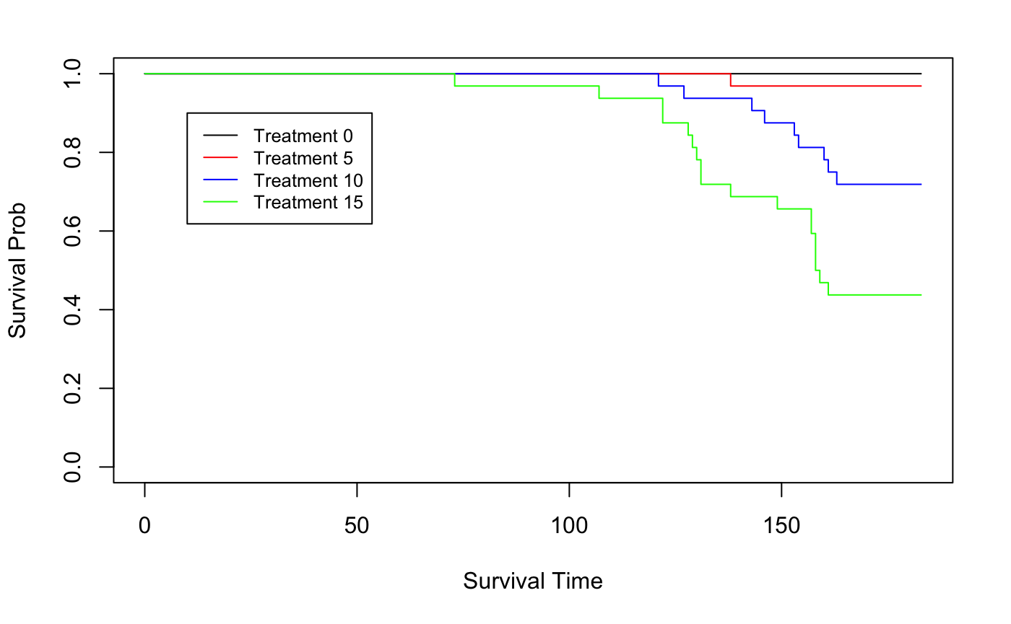
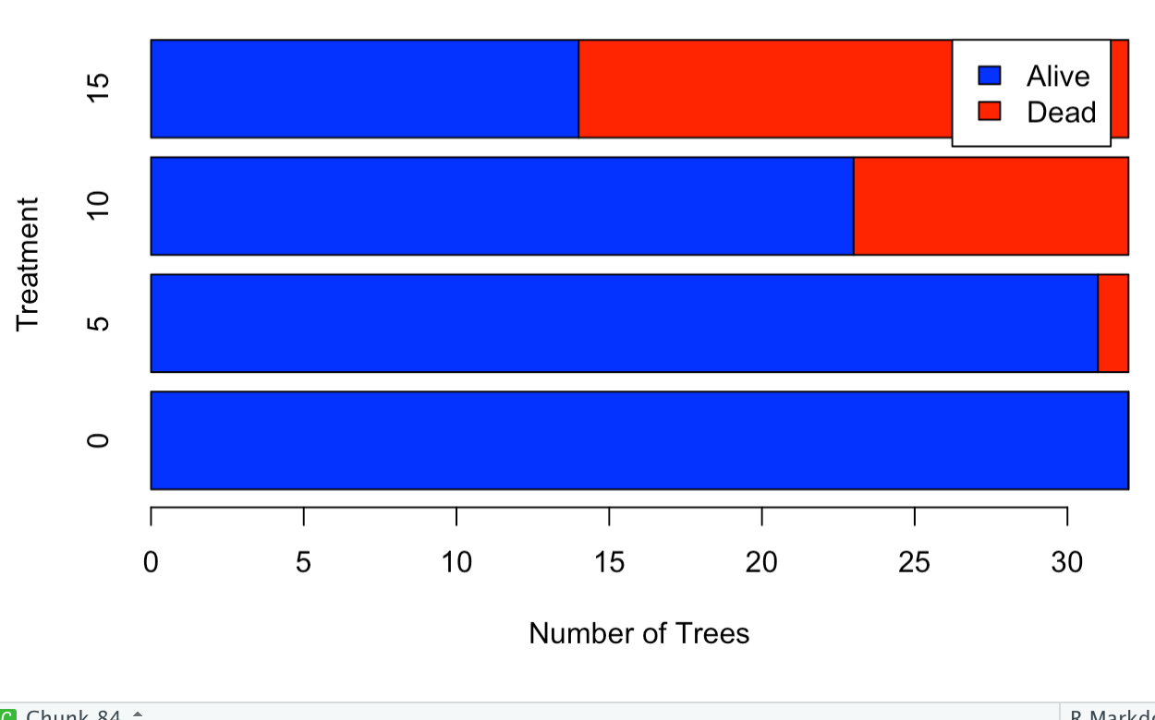
Survival Analysis (Salinity Data)
18
9
1
Pairwise Comparison Results: The following results were the only significant comparisons:
Trmt 0 & Trmt 10 Trmt 5 & Trmt 10
Trmt 0 & Trmt 15 Trmt 5 & Trmt 15
NOTE: The Julian start date was “95” (April 5th,2021), and the Julian End Date is 278(October 5th, 2021), so the experiment lasted 278-95=183 days.

Slide 20
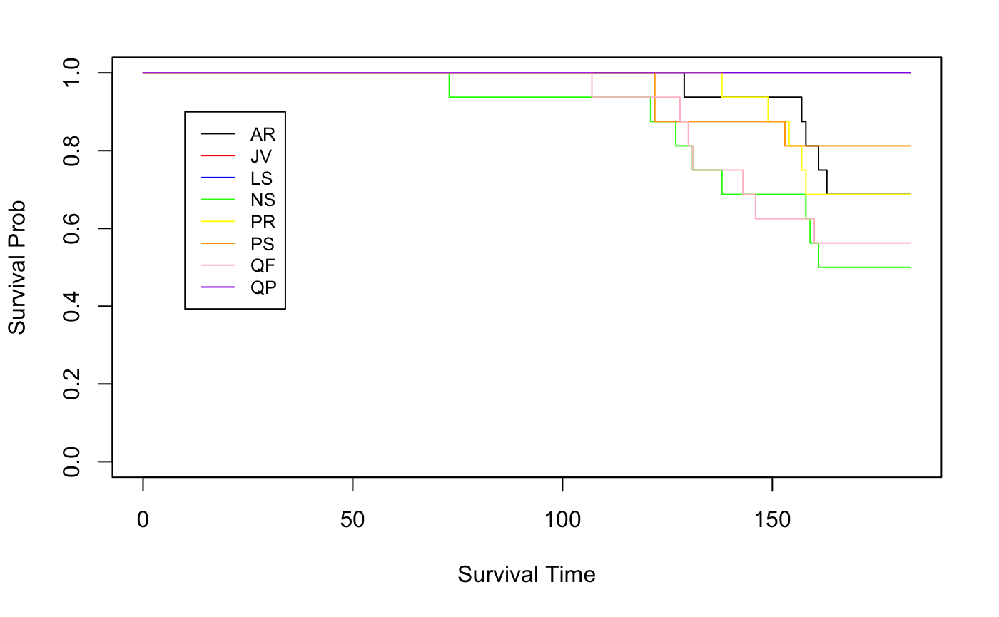
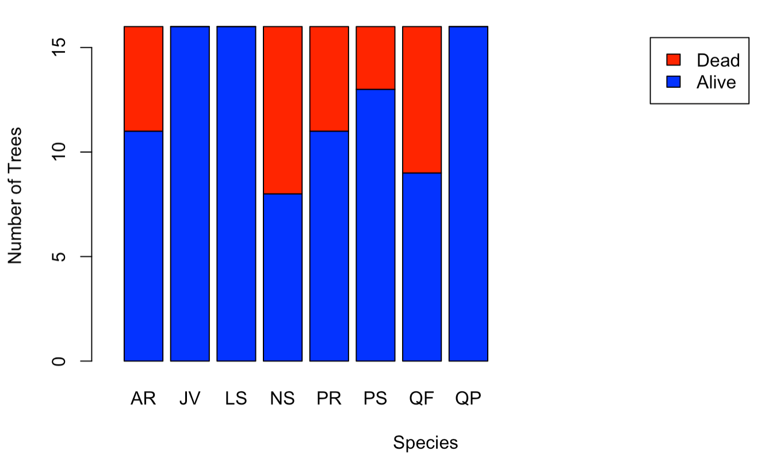
Survival Analysis (Salinity Data)
5
5
3
8
7
Pairwise Comparison Results: Only significant difference was between the plant species NS and all of the plants that survived the entirety of the experiment (JV, LS, QP).

Slide 21
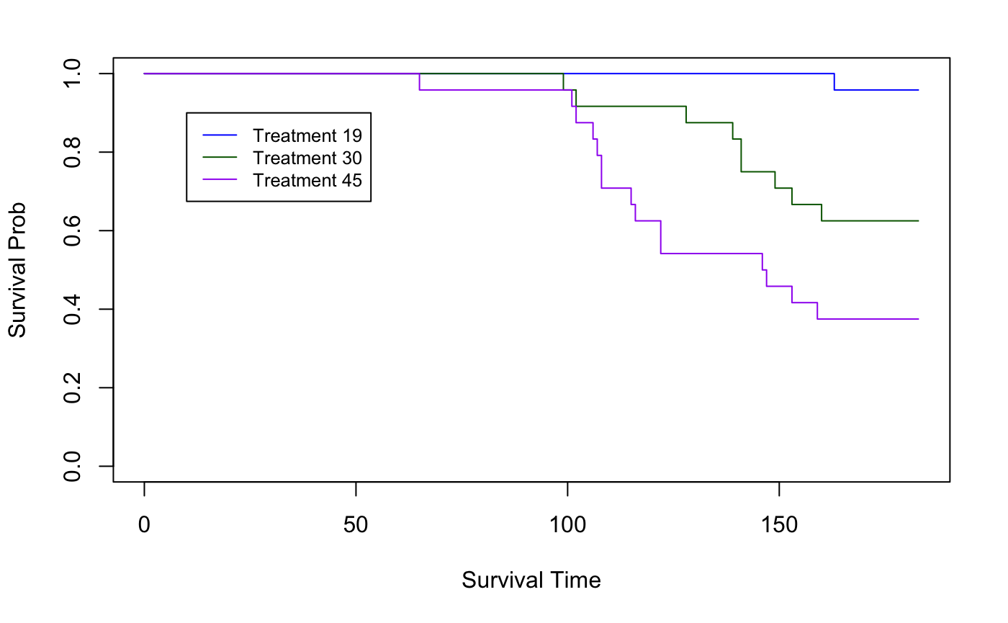
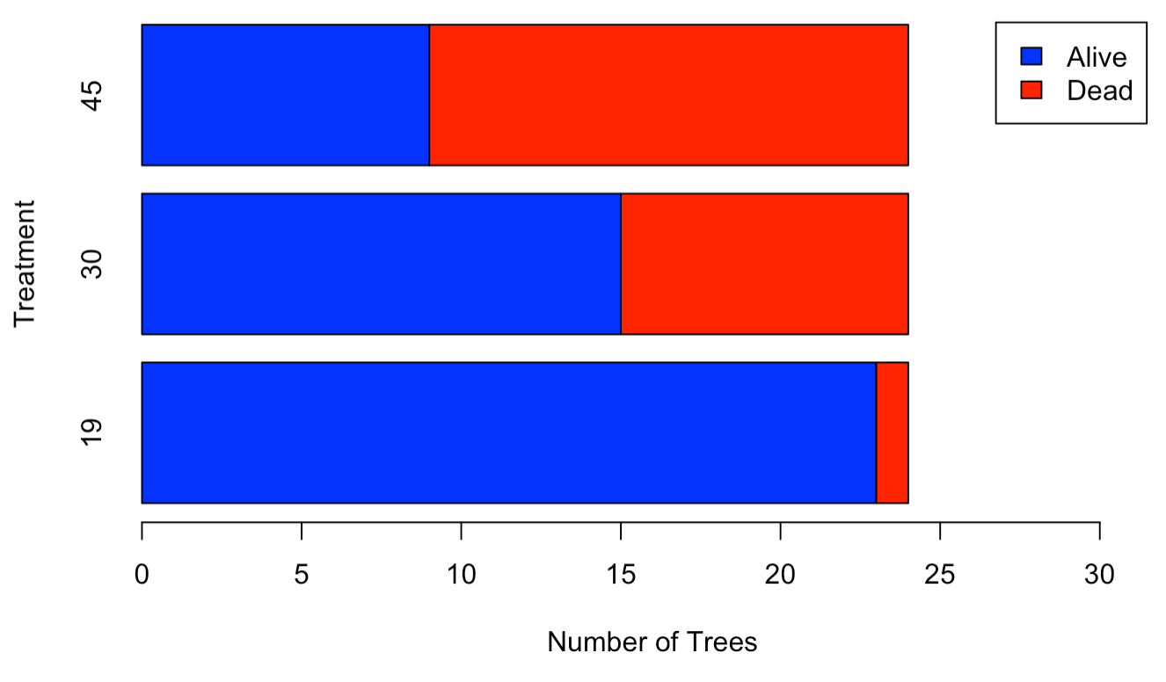
Survival Analysis (Frequency Data)
15
9
1
Pairwise Comparison Results: There was a significant difference in the number of plants that died with each grouping, excluding the comparison between Trmt 30 & Trmt 45.
Log Rank Test: Used to test the null hypothesis that there is no difference between the populations in the probability of an event (here a death) at any time point.

Slide 22
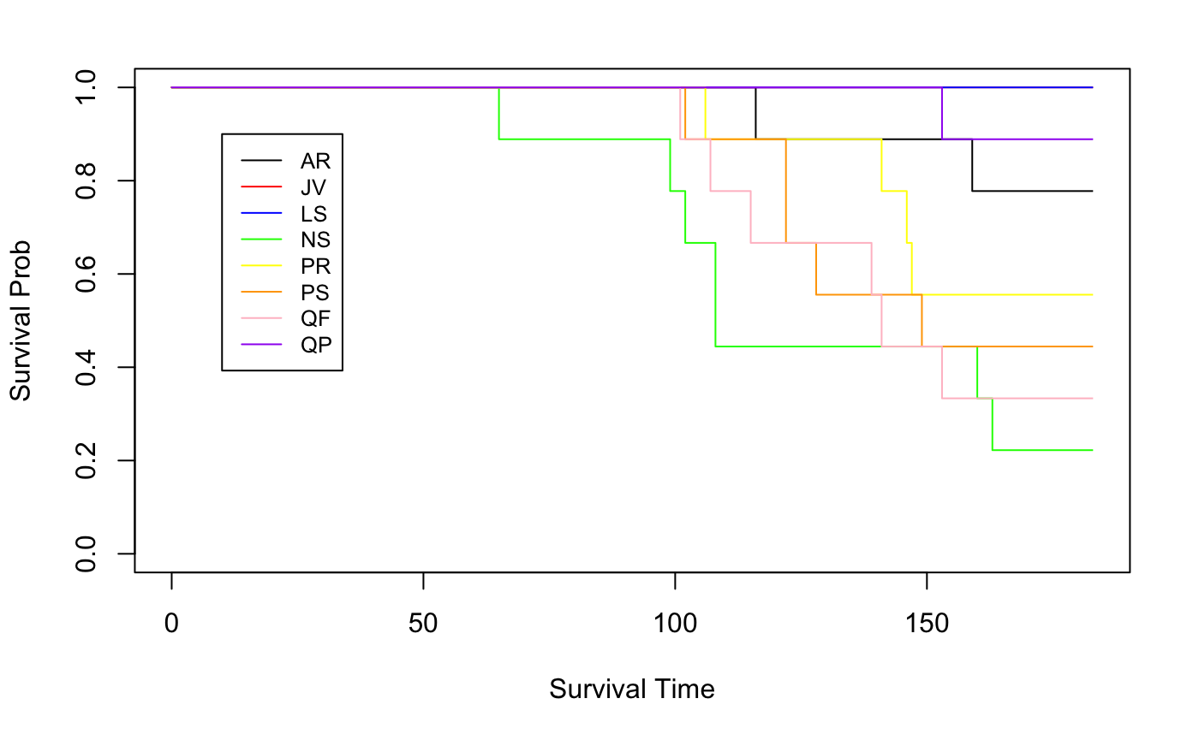
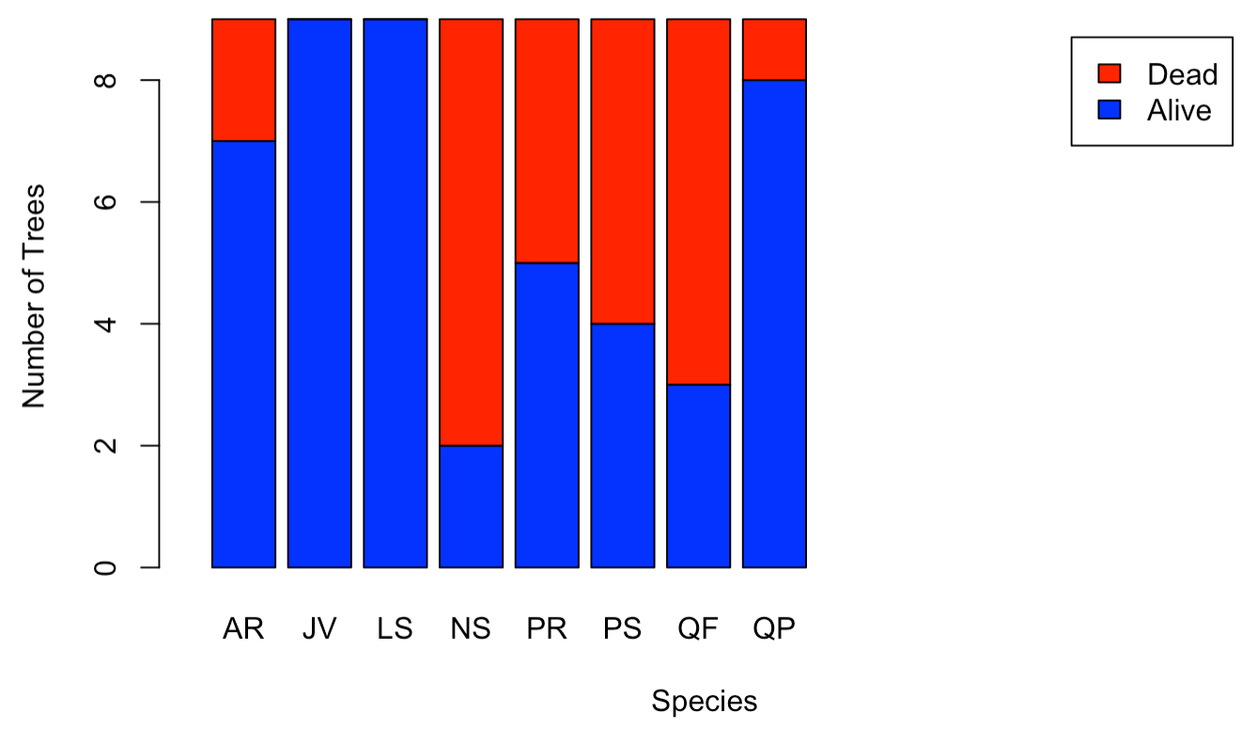
Survival Analysis (Frequency Data)
2
7
4
5
6
1
Pairwise Comparison Results: Only significant difference was between NS and JV, and NS and LS, aka the plant that had the most deaths (NS) and the plants with 0 deaths.

Slide 23
Conclusions
Salinity Experiment
There is a statistically significant difference in biomass by treatment for the following trees: Black Cherry (PS), Southern Red Oak (QF), Black Gum (NS), and Pitch Pine (PR).
There are smaller differences in biomass for the other 4 species
By analyzing the bar graph and the Kaplan-Meier curves we can see that as the levels of salinity increase, the probability of surviving decreases
In the duration of the experiment Black Gum (NS) reach the 50% survival mark
Frequency Experiment
There is a statistically significant difference in biomass by treatment for the following trees: Black Cherry (PS) and Southern Red Oak (QF)
There are smaller differences in biomass for the other 6 species
By analyzing the bar graph and the Kaplan-Meier curves, we can see that as the levels of frequency increase, the probability of surviving decreases.
In the duration of the experiment Black Gum (NS), Black Cherry (PS), and Southern Red Oak (QF) reach the 50% survival mark
Black Cherry (PS), Southern Red Oak (QF), and Black Gum (NS) seem to be the most vulnerable species in this sample

Slide 24
Questions?

Slide 25
Personal Reflections
Odalys
Kyle
Abby
I learned that the first thing you try will not always work and that is okay.
I learned that it is okay to question the client/group/your own ideas.
Out of all the times I’ve taken the class I feel like this was the first time I treated my client like a real client.
I am happy and honored to have been part of this class. I only have positive things to say about my experience in MA321. I have learned a lot and made great friends.
I learned that it is okay if your not perfectly on schedule, so long as the work gets done.
I learned that I know more about statistics than I thought I did.
This was the first time I felt calm talking with my client.
I am glad that I have taken this course. I had such a good time working with my client and with my groupmates. My only regret was not taking consulting more than I did.
I learned about Survival Analysis.
I learned that you can have a lot done on a project and realize later none of it can be used.
I learned that you can not predict initial biomass of a tree.
I really enjoyed working with two seniors because I learned so much from both of them.

